Slide 1
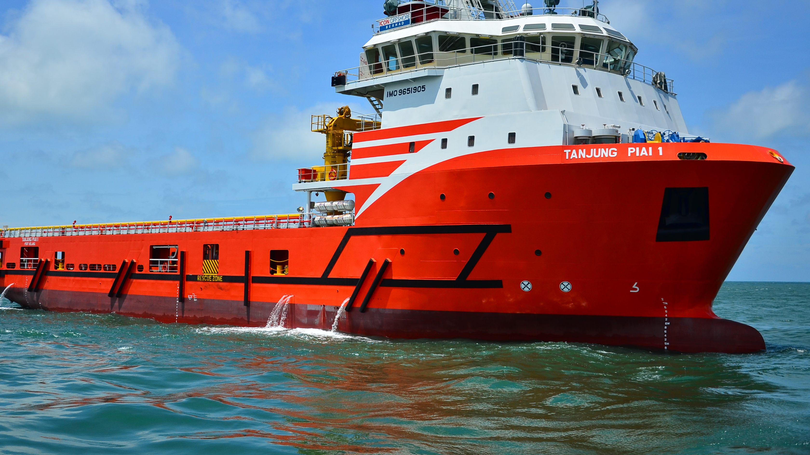
RNN Plan
Saab’s eternal quest to find a way to detect anomalies

Slide 2
Last week
Clustering was rejected

Slide 3
New plan
Clustering out of the window
Goal:
Find anomalies

Slide 4
What is an Anomaly
3-4 times out of the standard deviation when following a route
If ship speed deviates more than 2 times the standard deviation(95%) in that particular block
Making sudden course changes / movements

Slide 5
Why RNN
Find those strange movements in real time data

Slide 6
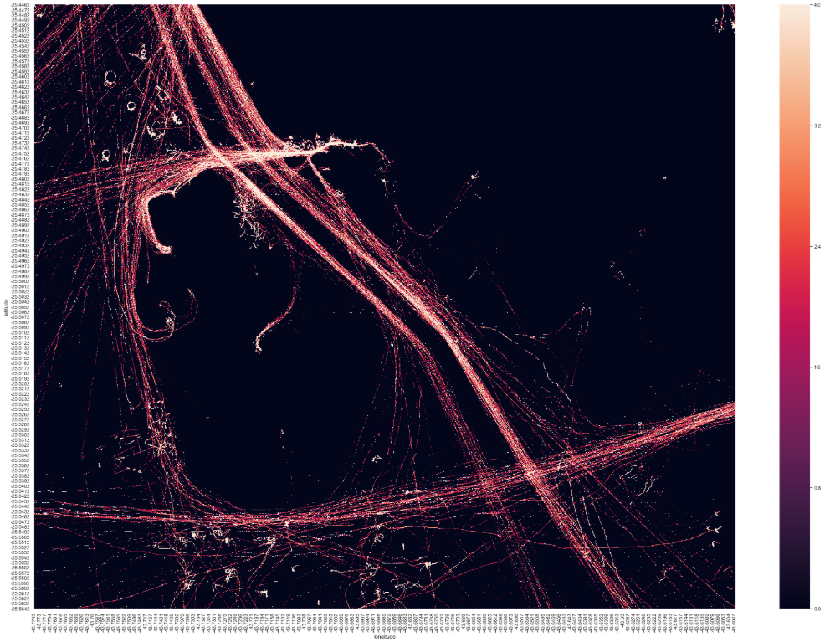
Data examples: Denisity heatmap

Slide 7
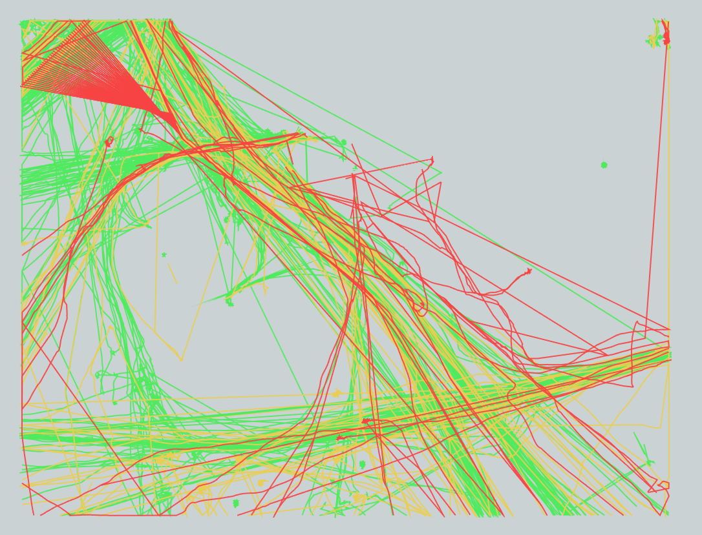
Rounding Lat/Long

Slide 8
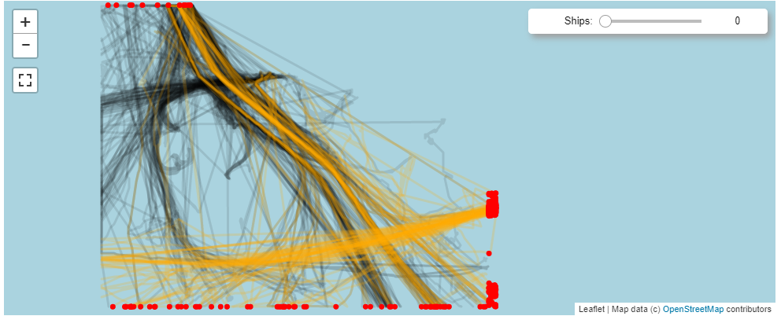

Slide 9
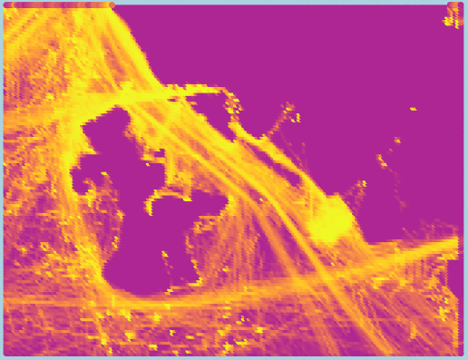

Slide 10
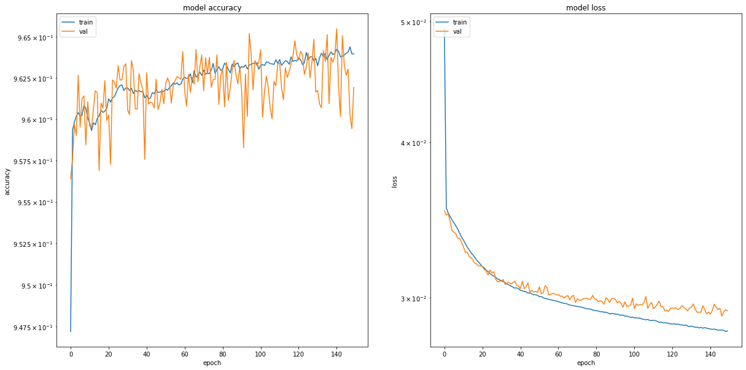

Slide 11
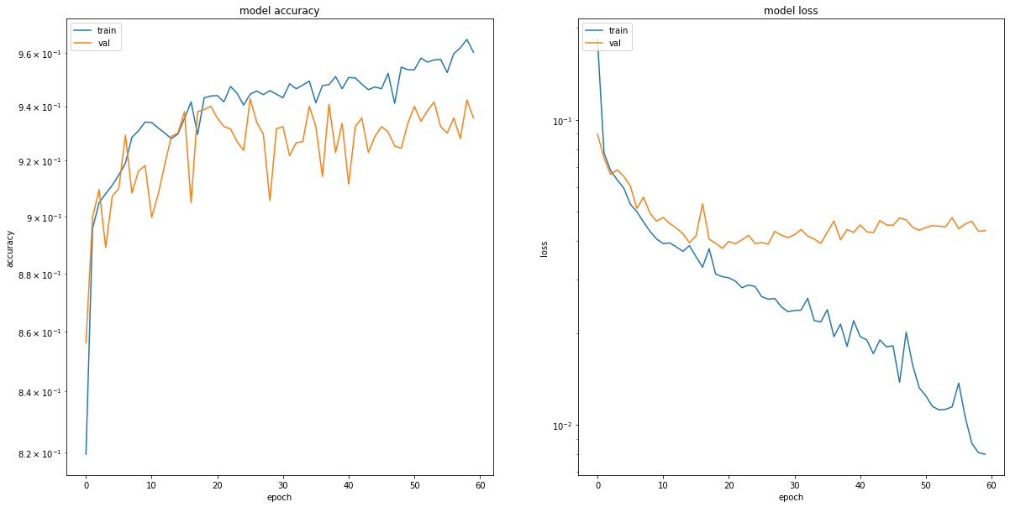

Slide 12
Feedback & questions?

